Slide 1
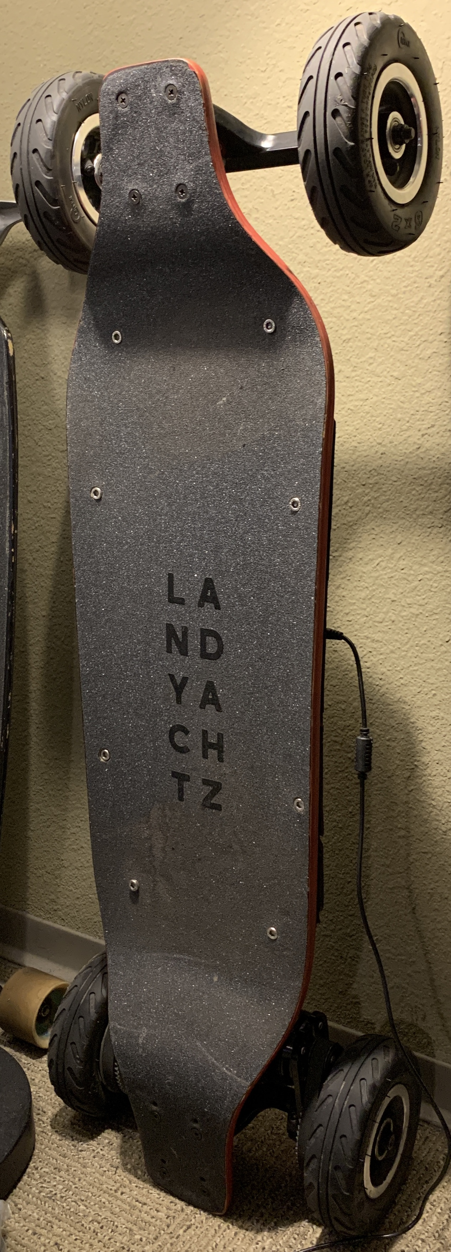
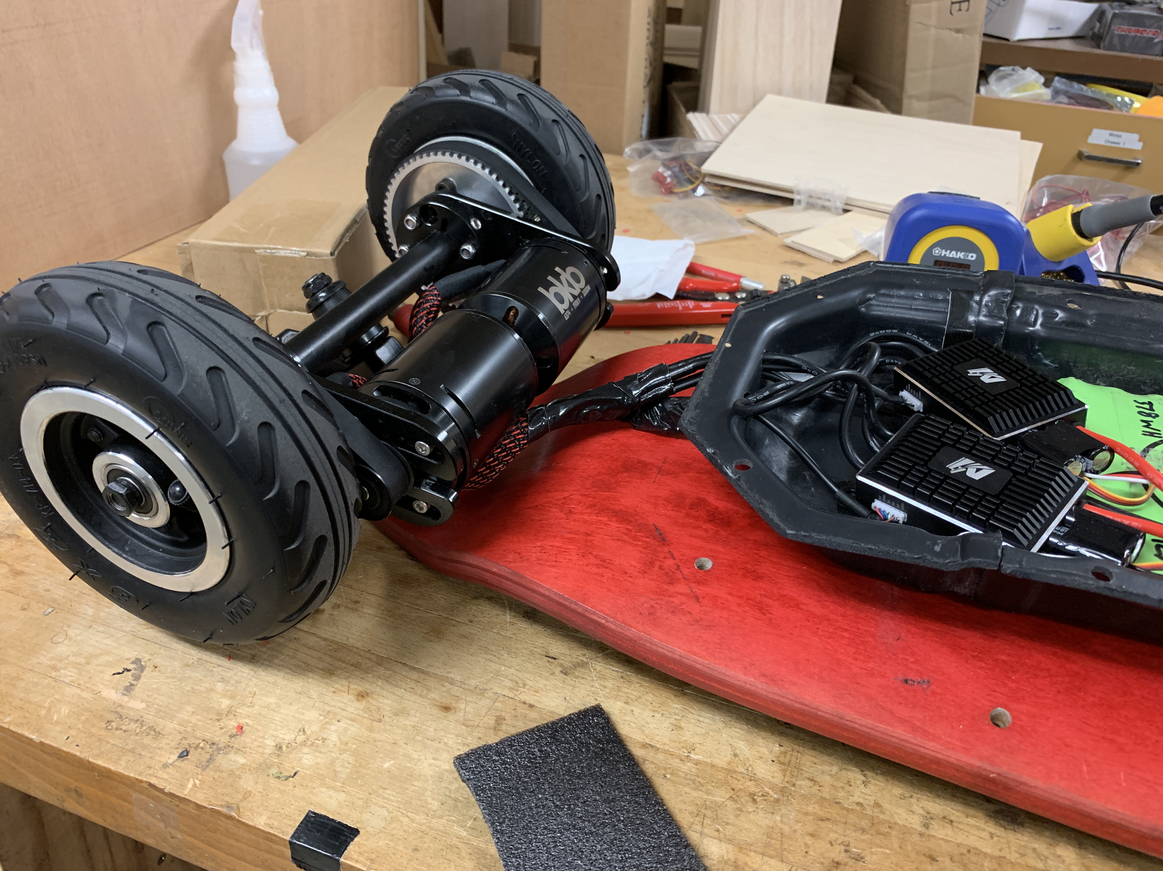
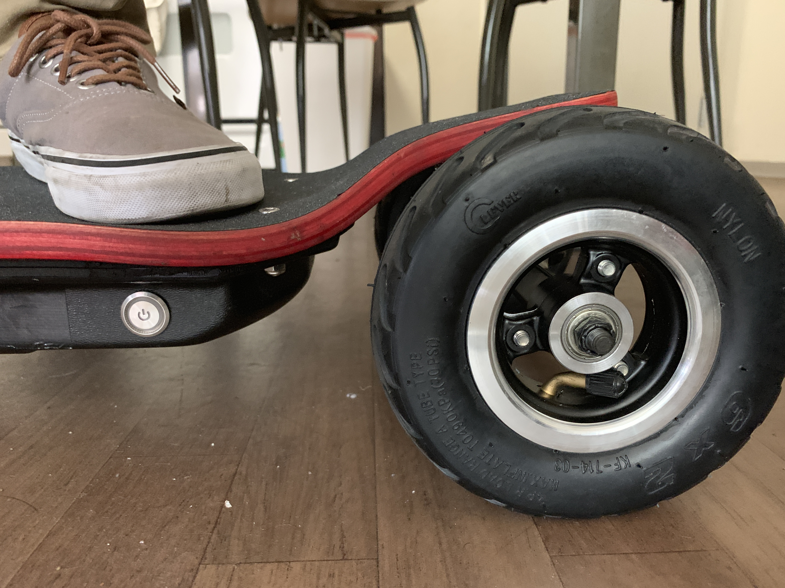
Designing an Electric Longboard
Ben Boggs

Slide 2
Design Goals
Top Speed 22+ mph
Range 5+ miles
Smooth ride over bad pavement/bricks
Little/no instability; reliable at speed
Carriable/draggable in a pinch (manageable weight)
Room to grow (Oversized propulsion allow headroom for future upgrades)

Slide 3
Design Process
Goal
Intended Solution
Stability at speed
Carriable/draggable
Landyachtz Evo Falcon
This deck has been designed for downhill longboarding where riders routinely reach speeds up to 45+ mph. The unique wedging where the trucks mount passively encourage dynamic stability, preventing speed wobble.
The 36” length and short ends make this deck more portable than traditional longboard decks.

Slide 4
Design Process
Goal
Intended Solution
Stability at speed
Carriable/draggable
Smooth ride
Landyachtz Evo Falcon
Pneumatic Tires
A stiffer deck will realistically require more damping from the wheels to compensate Having rode even 107mm Urethane wheels around LA, bumps can still be felt. Tire pressure can be controlled to provide a smoother ride

Slide 5
Design Process
Goal
Intended Solution
Stability at speed
Carriable/draggable
Smooth ride
Room to grow
Landyachtz Evo Falcon
Pneumatic Tires
6374 Motors, 100A VESCs
Pneumatic tires are much less efficient and require more power to roll, eliminating 50xx motors. 6355’s are cheaper, but have a lower ceiling and may lack torque when designed for speed. Additionally, at higher voltages they may reach the eRPM limit of the VESC-type speed controllers. 6374’s allow for more future upgrades.

Slide 6
Design Process
Goal
Intended Solution
Stability at speed
Carriable/draggable
Smooth ride
Room to grow
22 mph+, 5+ mile range
Landyachtz Evo Falcon
Pneumatic Tires
6374 Motors, 100A VESCs
10s3p Samsung 30q 18650 pack
6374’s generally run around 190 Kv. At 10s (30q’s cells are 3.7 V nominal) this results in enough rpm to reach 24 mph on 6” wheels with a high torque pulley ratio of 1:4. 3p is enough for ~14 mile range with urethane wheels, so should be enough accounting for tire efficiency losses. Additionally, I already owned this pack, reducing cost.

Slide 7
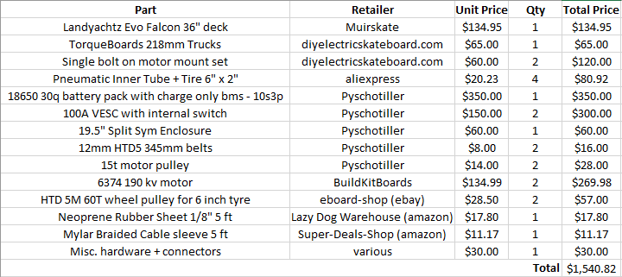
Final BOM

Slide 8
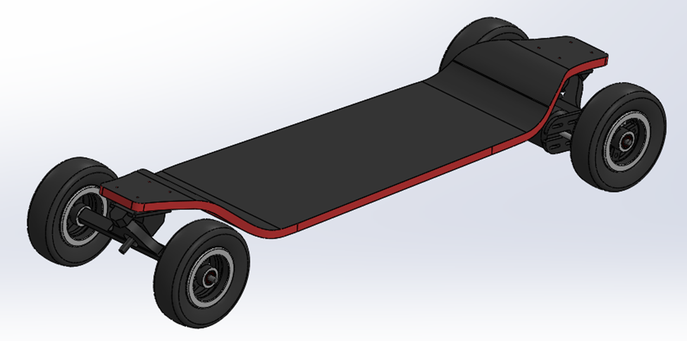
CAD model

Slide 9
Interferences & Concerns
Drive pulley bore intersects truck
Motor pulley interferes with mount/tire
Motors may interfere with deck on turns
Little axle left for drive wheel-retaining locknuts
Bolt-on mounts may be susceptible to slop in tight-clearance setup
File down truck for clearance
File down mount for clearance
Use at least ¼” risers for clearance
Consider reversing locknuts or use thinner nuts with spring washers
Consider drilling through truck and/or adding thrust bearings between mounts and drive pullies

Slide 10
Specs Tested
Top Speed 25+ mph (tested 25 mph at ~90% throttle)
Range 8+ miles (tested 8 mi with 30% charge left)
Smooth ride over bad pavement/bricks
Little/no instability; reliable at speed
Carriable/draggable. BONUS: stands up on its own
Room to grow—bigger battery possible

